Slide 1
Hotel Bookings Analysis
By Sameer Prajapati

Slide 2
📌Problem Statement
The hotel is facing a high rate of booking cancellations, which impacts revenue forecasting, resource planning, and overall customer satisfaction. The goal is to understand the key factors leading to booking cancellations using historical data, and propose actionable insights to minimize future cancellations.

Slide 3
⚠️📉Main Factors for Cancellations
Lead Time
Booking Source / Market Segment
Hotel Type
Country of Origin
Average Daily Rate (ADR)
Seasonality / Reservation Date

Slide 4
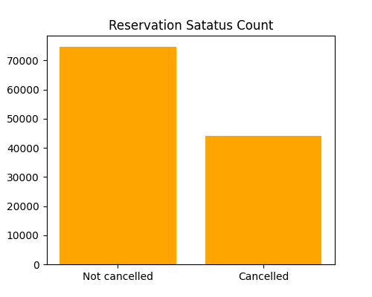
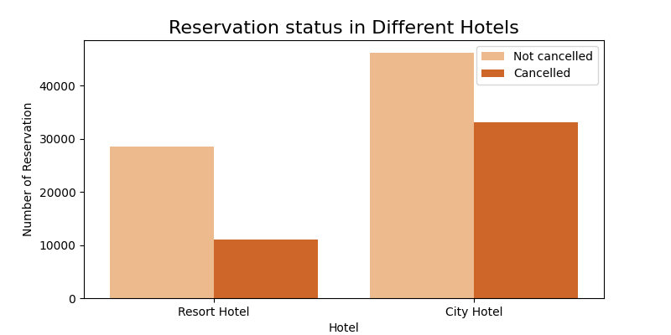
Analysis & Visualizations

Slide 5
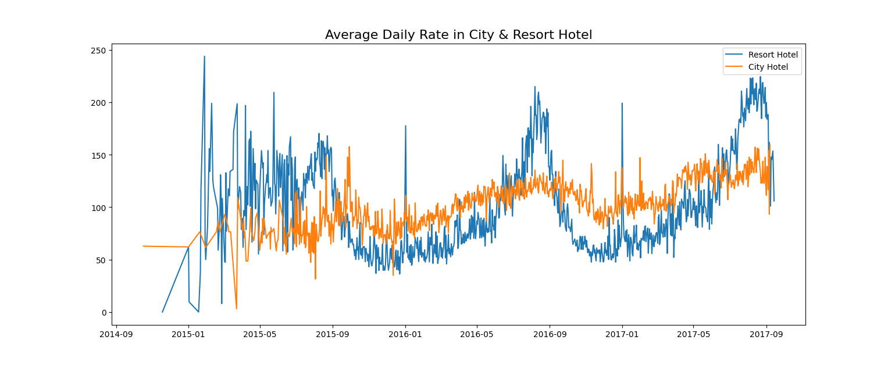

Slide 6
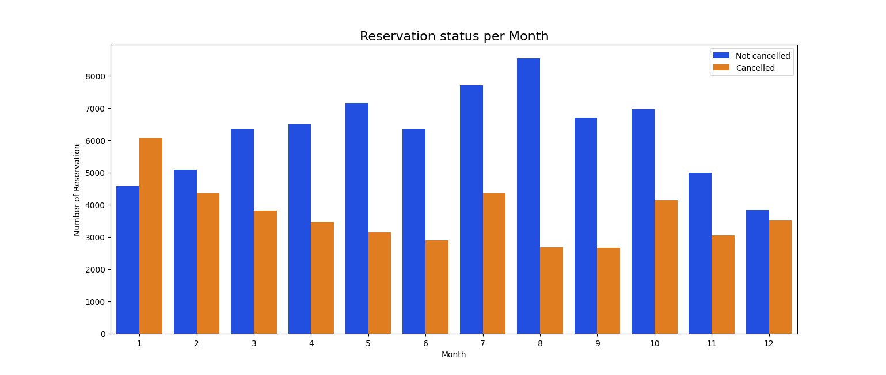
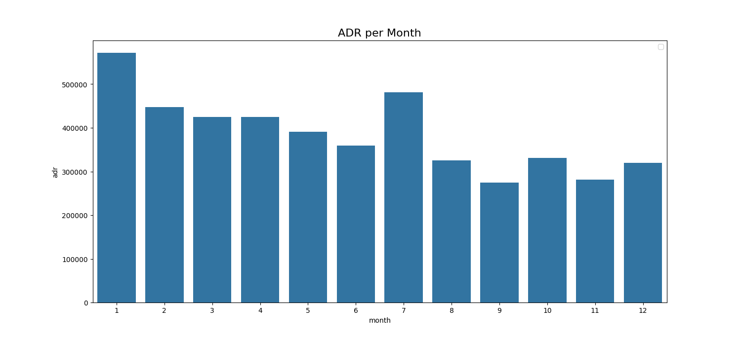

Slide 7
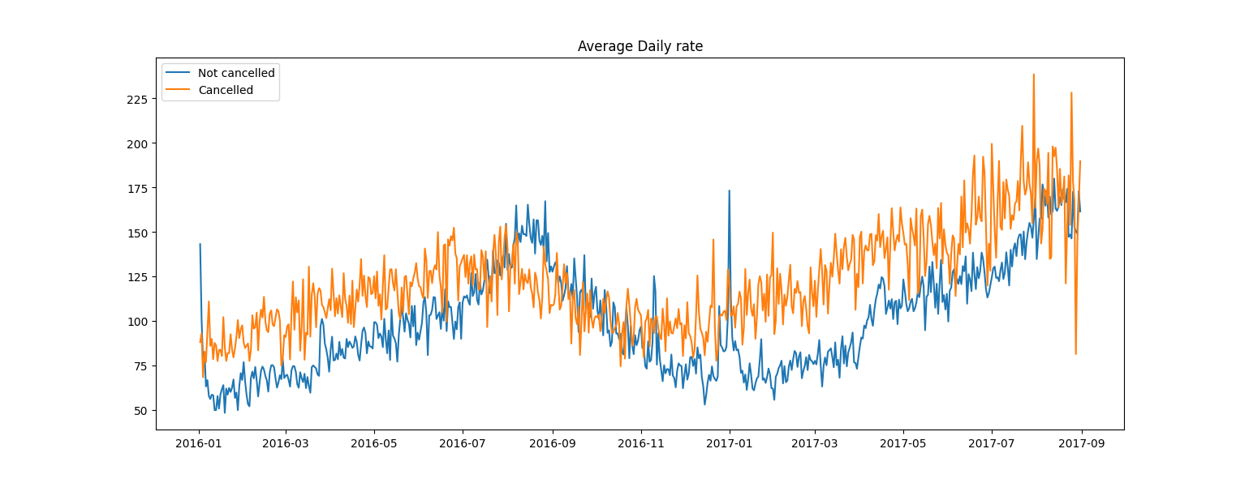
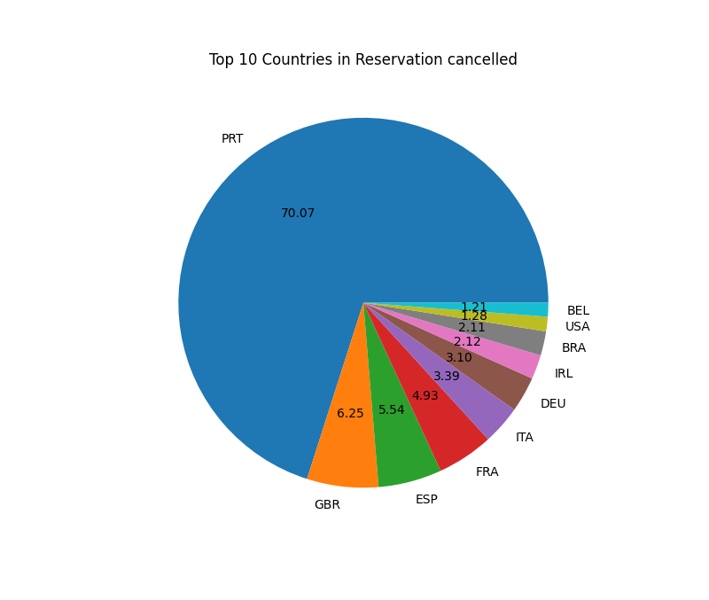

Slide 8
🧠Key Insights
City Hotels see higher cancellations than Resorts.
High ADR months correlate with higher cancellations.
Cancellations are heavily concentrated in Portugal.
More expensive bookings are at greater risk of being cancelled.

